Slide 1

Sentiment Analysis using Machine Learning CSCI417/ECEN425 – Project
Andrew Effat – 19105700
Salma Khaled – 19100068

Slide 2
Machine Learning Infographics
01
04
Abstract
Results/Discussion
02
05
Introduction
Conclusion
03
06
Methodology
Reference

Slide 3
Abstract
01
Sentiment analysis is growing more and more popular among businesses that seek to determine the emotions of their clients because of technological breakthroughs in areas like deep learning. Businesses now classify words into positive, negative, and neutral categories using natural language processing, statistical analysis, and text analysis to determine the sentiment.

Slide 4
Introduction
02
Sentiment analysis has developed into a potent tool for tracking and comprehending online dialogues as consumers share their opinions and thoughts about the brand more freely than ever before. You may discover what makes a customer happy or unhappy by automatically analyzing feedback and reviews from surveys or social media conversations. Additionally, you may utilize this information to customize your goods and services to match the needs of your clients and strengthen your brand.

Slide 5
Methodology
03
What is Sentiment Analysis?
Types of Sentiment Analysis
Fire-grained
Emotion Detection
Aspect Based
Multi-lingual
Importance of Sentiment Analysis
Implementation Steps

Slide 6
What is Sentiment Analysis?
AI
We have mentioned about the benefits of sentiment analysis, but it was not mentioned what is actually sentiment analysis.
Analysis of the customer's positive or negative attitude in text is known as sentiment analysis. Businesses can monitor online chats to use contextual analysis of identifying information to better understand the social attitude of their customers.

Slide 7
Types of Sentiment Analysis
01
02
Fire-grained
Emotion Detection
Positive
Neutral
Negative
Very Negative
Sentiment Analysis
03
04
Aspect Based
Multi-lingual

Slide 8
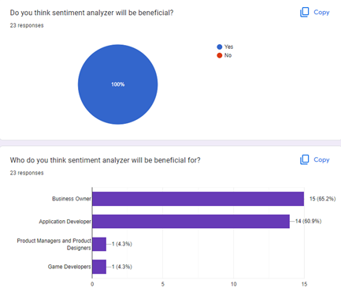
Importance of Sentiment Analysis
The most important benefit of sentiment analysis is that it makes it possible for you to comprehend how your clients feel about your brand. By automatically assessing the thoughts and sentiments of your customers through social media chats, reviews, polls, and more, you can enhance your goods and services and make better decisions. According to our survey, 23 people responded, and they all agree that sentiment analyzer is beneficial, and also, they suggested for whom is the analyser beneficial for.

Slide 9
Implementation Steps
1) Data Pre-processing
2) Text Classifier
3) Model Training
4) Model Execution
ML for business

Slide 10
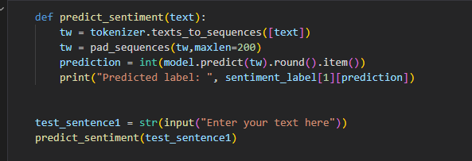
Results/Discussion 1
04
The user enters any text of his own, the function first tokenizes the text to break it down to tokens, padding these tokens to have the same length. Finally we predict the sentiment of the input text, and the put is then displayed.

Slide 11
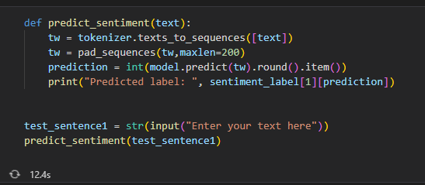
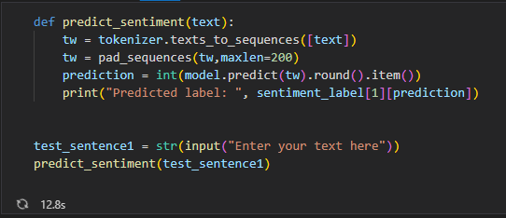
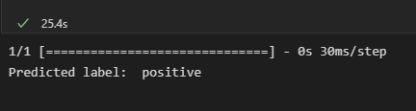

Results/Discussion 1
a. Positive Text: b. Negative Text:

Slide 12
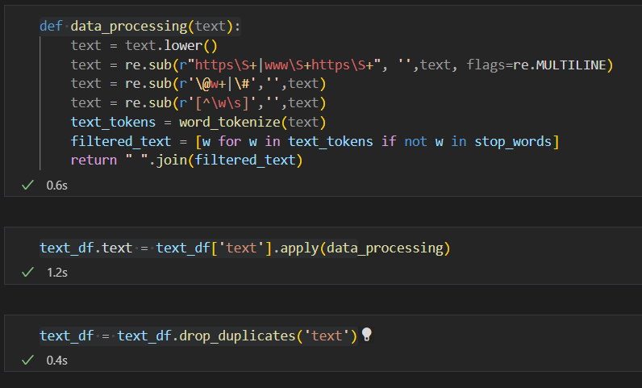
Results/Discussion 2

Slide 13
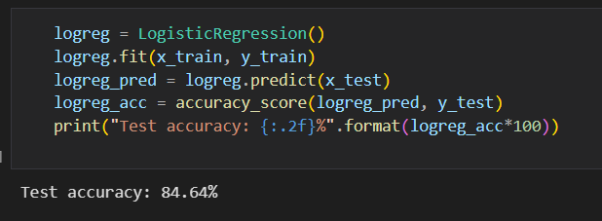
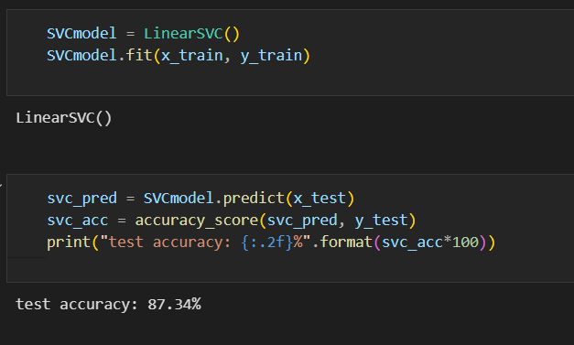
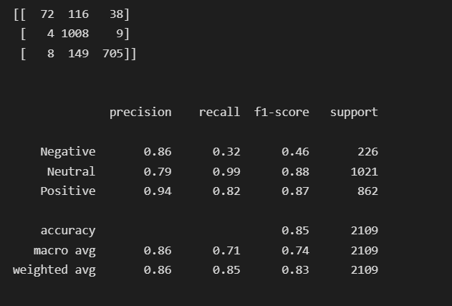
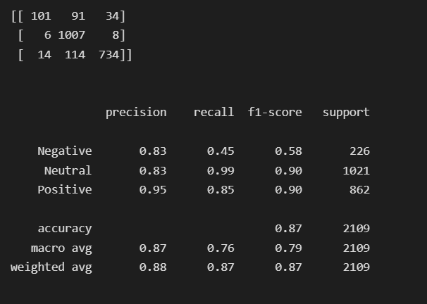
Results/Discussion 2
a. Logistic Regression Mode: b. Linear SVC Mode:

Slide 14
Conclusion
05
Due to the development of technology, the era of gaining insightful data from surveys and social media has come to an end. As a result, it is now important for your company to be aware of how your clients are feeling. To maximize the potential of data and gain the most insightful understanding, businesses are utilizing sophisticated classifiers like sentiment analysis and contextual semantic search. Utilizing technologies for natural language processing, you may create business strategies, meet, or exceed customer expectations, generate leads, create marketing campaigns, and uncover new growth opportunities.

Slide 15
Reference
06
[1] “Introduction to Sentiment Analysis: Concept, Working, and Application,” Maruti Techlabs, Oct. 08, 2021. https://marutitech.com/introduction-to-sentiment-analysis/
[2] “Sentiment Analysis using Python [with source code],” TechVidvan, Jun. 14, 2021. https://techvidvan.com/tutorials/python-sentiment-analysis/

Slide 16
Thank You !

